Slide 1
Lecture 1: LP Duality
Week 1 MGMTMSA 408 – Operations Analytics Prof. Velibor Misic

Slide 2
Introduction
Before MGMTMSA408, you learned about optimization models in MGMTMSA403, and in particular, linear programs
In this lecture, we will delving into some more advanced topics:
What is a dual problem?
What is a shadow price/dual variable?
How can we use shadow prices to understand the sensitivity of our original linear program to changes in the problem data?

Slide 3
Tools
We will use a combination of three tools:
Python: a general purpose programming language
Gurobi: a solver for optimization problems
Jupyter Notebook: a tool for presenting code and text
I will be using this for in-class demonstrations of Python + Gurobi
See https://jupyter.org for more information

Slide 4


Gurobi
A commercial solver for optimization problems
Has a long history:
Back in late 1980s, CPLEX: software for linear optimization
Acquired by ILOG (a French company) in 1997
ILOG later acquired by IBM
IBM did not really appreciate CPLEX
Three main figures behind CPLEX – Zonghao Gu, Ed Rothberg and Robert Bixby – left CPLEX in 2008, and founded Gurobi

Slide 5







Gurobi
Today, Gurobi is the best software out there for solving large linear, mixed-integer and quadratic optimization problems
It is not free, but academic users can obtain free licenses
Gurobi is used by various companies:
Notes:
Michael North, senior director of the NFL: ““When you take into account the teams, games, stadiums, possible game days, the length of the season, and all of the other factors that go into decision-making, the number of combinations is enormous. Imagine adding two hundred zeroes onto a trillion; that's still well short of the total number of possible NFL schedules each year. Time pressure is also a major issue; we have just under three months each year to complete this hugely complex task.”

Slide 6
Production problem
Let’s start by solving a simple production planning problem…

Slide 7
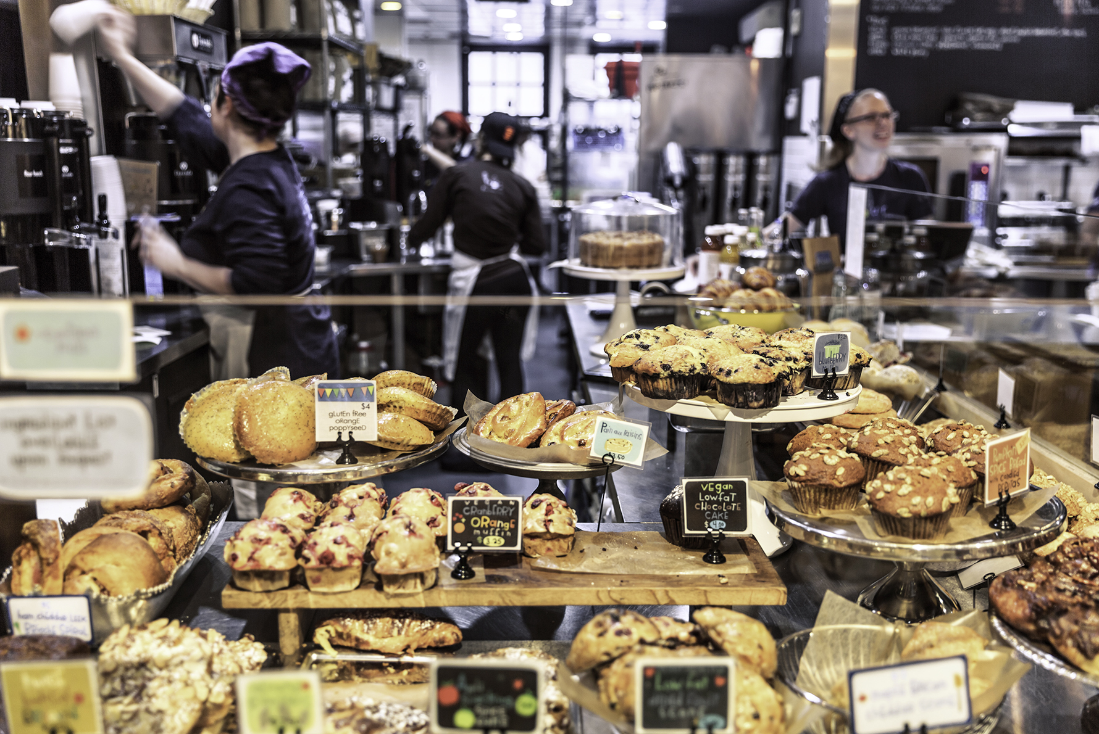
Production problem
Each week, we produce three different types of baked goods:
Buns, Croissants, Muffins
Each unit of each baked good requires some raw ingredient: Butter, Flour and Sugar
Each baked good has a different unit price
How much should we produce of each baked good to maximize revenue?

Slide 8
Production problem
Unit prices:
Buns = $3.00/unit, Croissants = $4.00/unit, Muffins = $4.50/unit
Raw ingredients:
1 bun requires:
20g of butter, 100g of flour, 0g of sugar
1 croissant requires:
100g of butter, 50g of flour, 50g of sugar
1 muffin requires:
10g of butter, 0g of flour, 150g of sugar
We have 26kg of butter, 80kg of flour, 5kg of sugar on hand
Take 2 minutes right now to formulate the problem

Slide 9
Production problem in Python + Gurobi
This problem is a linear program or linear optimization problem
A program = a “plan”
Arose as a tool for planning military resource/expenditure allocations in World War 2
Let’s see how to formulate this problem in Python + Gurobi

Slide 10
Bounding our LP
Suppose I asked you this question:
Can you obtain an upper bound on the best possible revenue, without solving the LP?

Slide 11
The best bound for our LP
Now a different question:
Using the technique that we just saw, what is the lowest upper bound on the objective value that you can obtain?
Take 2 minutes to try this right now

Slide 12
Dual LP
The problem of finding the lowest (i.e., tightest) upper bound on the optimal value of our original problem is called the dual linear program or dual problem
To distinguish it from the dual problem, the original problem is called the primal linear program or primal problem
Let’s formulate and solve the dual LP in Python/Gurobi

Slide 13
Weak and strong duality
The primal and dual problem are closely related
Weak duality says that the objective value of a primal feasible solution will always be upper bounded by the objective value of a dual feasible solution
Strong duality says that the optimal objective value of the primal and dual problems are the same

Slide 14
Interpreting dual variables
We saw that the dual problem can be interpreted as finding weights for our primal constraints that would give us the tightest upper bound
Another interpretation is that a dual variable tells us the “value” of a resource

Slide 15
Dual variables as prices
Suppose that an outside party wanted to purchase our raw ingredients (butter, flour and sugar), and offered us prices p_{B}, p_{F} and p_{S}
Suppose that this outside party wanted to minimize how much it spends on these raw ingredients
What is the objective?

Slide 16
Dual variables as prices
In addition, the outside party must offer us prices that are sufficiently “attractive”
For example, consider buns:
Suppose that we are offered $0.05/g for butter, $0.03/g for flour and $0.05/g for sugar
Suppose we took the ingredients required to make a single bun – 20g of butter, 100g of flour, 0g of sugar
Is it better for us to use those ingredients to make the bun, or to sell those ingredient quantities to the outside party?
What if we were offered $0.01/g for flour?

Slide 17
Optimal dual solution
The main solution algorithms for linear programming – the simplex method and interior point methods – work by effectively maintaining both a primal and a dual solution
Thus, when we solve the primal problem, we obtain the primal optimal solution, but we also obtain the dual optimal solution for free

Slide 18
Sensitivity
In linear programs, we are sometimes interested in understanding how the optimal value changes when we change the constraints
The optimal dual variables directly quantify this:
Optimal dual variable of constraint i: the marginal change in the objective for a change in the right hand side of constraint I
The optimal dual variable of a constraint is also sometimes called the shadow price of that constraint

Slide 19
Sensitivity – bakery example
In the bakery example – suppose that we can buy additional flour at a price of $5/kg
Should we buy it?
To decide, we compute the shadow price of flour:
Instead of consider where is very small
What is the change in the objective value?

Slide 20
Dual information
Let’s see how to access dual information in Gurobi

Slide 21
Some historical context
You may have touched briefly on the history of LP in MGMTMSA403
LP was independently invented by George Dantzig in the US in the 1940s, and Leonid Kantorovich in the USSR in the 1930s
Kantorovich later received the Nobel Prize in Economics in 1975

Slide 22
Shadow prices are controversial!
How do you value 5kg of flour?
How much time the farmer spent growing the crops, how much the farmer spent on the seeds, etc.
From the LP perspective, what is the value of 5kg of flour?
The value is how much additional revenue we get when we optimally use that flour
From F. Spufford’s Red Plenty:
Boyarskii: “I am referring to your objectively [determined] valuations… which have become a challenge to political economy’s central truth, its great foundation stone: that all value is created by labour. “Shadow prices”, I believe they’re also called – and they are shadowy indeed, are they not? … what can this possibly be but a suggestion that value is created by supply and demand? Supply and demand for heaven’s sake: bourgeois ideology’s most transparent disguise for exploitation!”

Slide 23
Summary
Duality and the dual problem provides an additional perspective on a linear programming problem
Optimal dual variables give us a way to “value” resources
This is essential to algorithms that dynamically allocate resources, as we will see for network revenue management (Week 3)
This is also essential to algorithms that seek to avoid enumerating all possible decision variables, which is the key idea of column generation (Week 2)

